Slide 1
Squirrel Programming Language
Matt McCarthy & Joshua Maravelias

Slide 2
A little review...
Dynamic Typing
Python, Javascript most scripting languages etc
All Types at run-time
Typical slower and more memory
Static Typing
C, C++, Java etc
Everything* checked at run-time
Usually faster and more efficient on all axes

Slide 3
Looks like C? Feels Like Python?
Must be Squirrel:
"a high level imperative, object-oriented programming language, designed to be a light-weight scripting language that fits in the size, memory bandwidth, and real-time requirements of applications like video games"
Imperative
Object Oriented
Dynamically Typed
As fast as C
Low Memory
Notes:
Also mention lambda expressions and threads and stuff

Slide 4
Cool Features
local coolQuote = @'"Beware of bugs in the above code;
I have only proved it correct, not tried it."
-- Donald Knuth'
"Beware of bugs in the above code;
I have only proved it correct, not tried it."
-- Donald Knuth
String Literals
Optional Garbage Collector
Java-Like Threads
function coroutine_test(a,b){
… // calculate the lcm
}
function someotherfunction(){
…
local thread = ::newthread(coroutine_test);
local lcm = thead.call(m,n);
…
if( lcm.getstatus != "suspended")
::print("The lcm is "+lcm+".");
...
}
Notes:
Animation for String Literal and threads

Slide 5
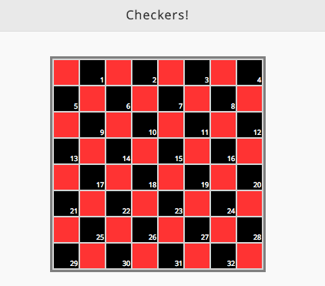
Come Check It Out...
Checkers: Man vs. Machine
http://bit.ly/1jPKYq8

